Slide 1
MVP Presentation — Team Akira
Idea Title : ClaimFlow Agent Builder
Team Captain Name : Shresth Agarwal
Team Members : Shresth, Srivalli, Praharshitha, Tanish
Team Name : Team Akira

Slide 2
ClaimFlow Agent Builder
Problem Statement
Solution Description
Filing an insurance claim is often overwhelming. The process is packed with paperwork and confusing steps, and many people don’t know what documents or evidence are required. This leads to delays, smaller settlements, or even unfair treatment.
Claimants struggle with basics—figuring out damage, checking eligibility, and gathering proofs like bills, FIRs, repair estimates, medical records, and photos.
For rural and first-time claimants, the hurdles are even higher. Language barriers, limited awareness, and lack of guidance make the process intimidating and leave them more vulnerable to mistakes or exploitation.
ClaimFlow helps users prepare for the insurance claiming process before they approach the insurance agent.
The platform guides users in collecting the right documents, organizing proofs, understanding damage severity, and estimating possible settlement amounts.
It simplifies the overall claiming process and helps users avoid confusion, delays, and incomplete submissions.
By acting as a smart assistant between the customer and the insurance company, ClaimFlow helps users submit stronger and more organized claims with greater confidence.

Slide 3
ClaimFlow Agent Builder
Uniqueness / Innovativeness
Business Impact
What makes ClaimFlow uniquely different:
Focuses on helping the customer before claim submission, not just processing claims after submission
Helps users understand what documents and proofs are required
Assists users in preparing for negotiation with insurance agents
Provides estimated damage value and possible settlement guidance
Reduces dependency on middlemen and manual guidance
Designed to support common users, including rural and first-time claimants
Works across multiple insurance types such as crop, health, motor, and property insurance
ClaimFlow reduces the complexity and uncertainty faced by insurance claimants by helping them prepare stronger and more accurate claims.
This can significantly reduce:
claim delays,
incomplete submissions,
fraudulent activities,
settlement disputes,
manual verification workload.
For customers, the platform improves transparency, awareness, and confidence during negotiations with insurance agents. For insurers, it can reduce operational overhead, improve claim quality, and accelerate claim validation workflows.
By combining AI-driven document intelligence, settlement estimation, and fraud-risk interpretation, ClaimFlow creates a scalable foundation for faster, fairer, and more accessible insurance claim assistance

Slide 4
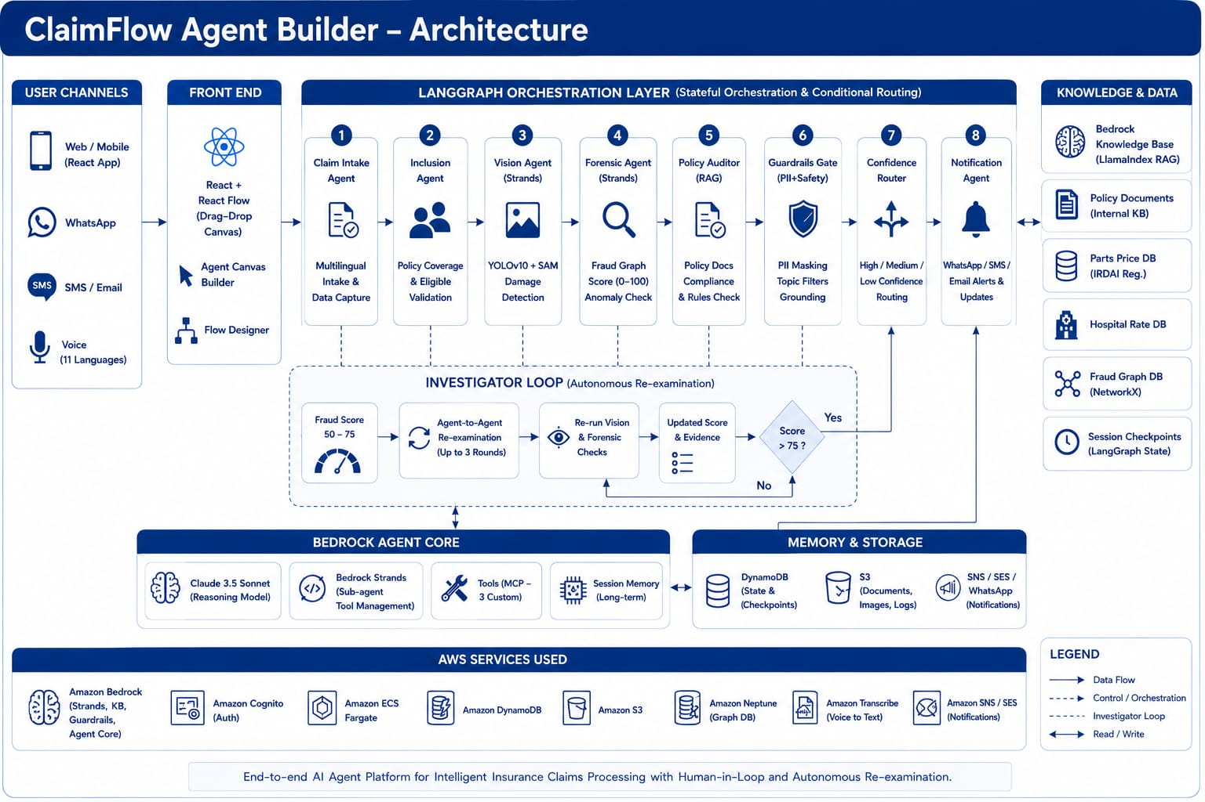
ClaimFlow Agent Builder
Technical Design and architecture
** Use additional slides to include other relevant details, as required.

Slide 5
ClaimFlow Agent Builder
Scalable / Reusable
Roadmap
Real-World Deployability
End-to-end claim pipeline runs on AWS ECS Fargate — production-grade, zero server management.
Multi-Insurer Configuration
MCP custom tools (Parts Price, IRDAI Reg, Hospital Rate) are swappable per insurer. LangGraph state machine adapts routing rules without code changes.
Multilingual by Design
Bhashini + AWS Transcribe supports 11 languages — deploy across India's linguistic diversity from day one.
Modular Agent Architecture
Each agent (Vision, Forensic, Policy Auditor, Guardrails) is independently deployable. Swap Claude 3.5 Sonnet for any Bedrock model. Add new Strands tools without rewriting orchestration.
React Flow No-Code Canvas
Non-technical teams can visually configure claim workflows via drag-and-drop, reducing IT dependency for adapting to new business rules.
Phase 1 — Propensity Modelling
Build customer propensity models using historical claims data and ML to predict fraud likelihood, churn risk, and upsell opportunities — enabling proactive insurer interventions before claims are filed.
Phase 2 — Sustainable AI (Green LLM)
Implement quantization, knowledge distillation, and energy-aware prompting to reduce the carbon footprint of LLM inference. Target: 40–60% reduction in GPU compute per claim processed on Bedrock.
Phase 3 — Multimodal Intelligence
Expand Vision Agent to ingest video dashcam footage, audio witness statements, satellite imagery, and IoT sensor data simultaneously — enabling holistic risk scoring and faster settlement decisions beyond static photos.

Slide 6
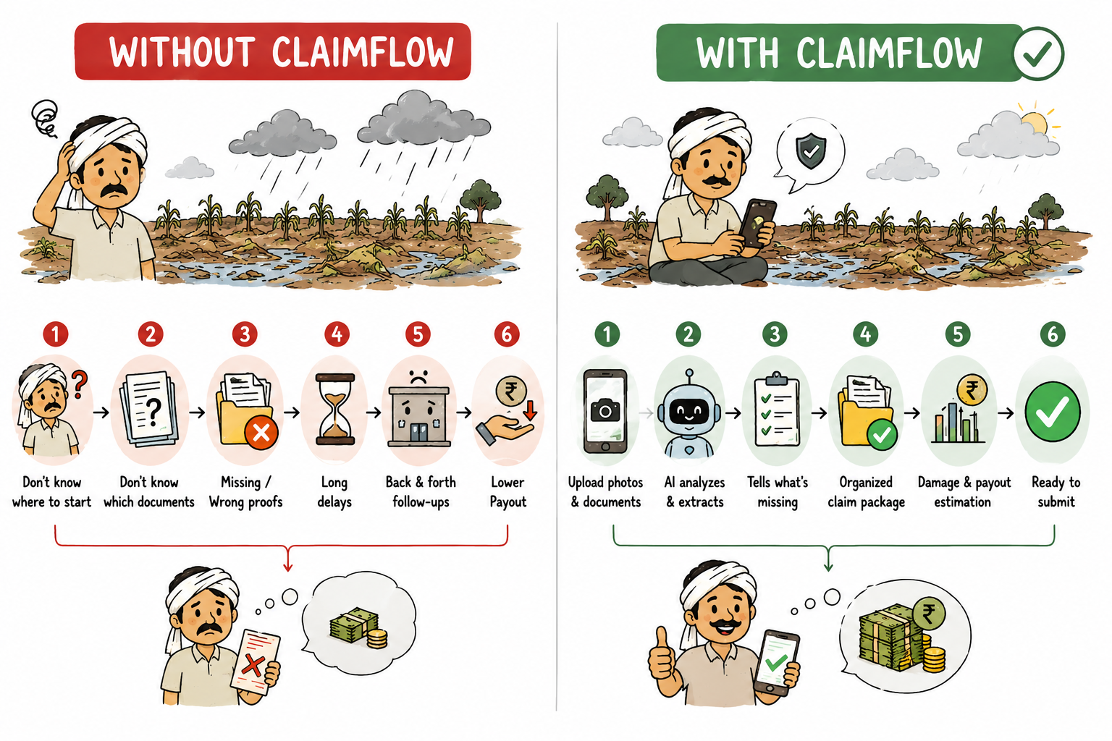

Slide 7
Source Code & Project Repository: GitHub – ClaimFlow [https://github.com/Shresth-Agarwal/ClaimFlow]

Slide 8
Thank you

